Slide 1
MOGA-CmpCNN: A Multi-Objective Genetic Algorithm Intergrated with CmpCNN Model for CMP-Aware Metal Fill
Presenter : Min-Feng Hsieh
Advisor : Ting-Chi Wang

Slide 2
Outline
Introduction
Preliminaries
Proposed Algorithm
Previous methods
Barzilai-Borwein Method Enabled Nesterov Algorithm
Macro Legalization
Experimental Result

Slide 3
Introduction
Chemical Mechanical Polishing (CMP) 化學機械拋光
Achieving uniform planarization in the fabrication of integrated circuits (ICs).
Using metal fill can maintain the uniform metal density, which is important for CMP.
Metal fill generally contain 2 phases:
Fill synthesis.
Determine the amount to be inserted.
Fill insertion.
Place the fill in the layout.
Notes:
*实现均匀平坦化

Slide 4
Introduction
Rule-based metal fill algorithms
The Density related rules can result in larger post-CMP height variations.
Model-based algorithms
Accounting only for density/perimeter factors requires improvements for better predictive accuracy.
Embracing machine learning (ML) techniques
NeurFill: with a CMP neural network as the CMP simulator for fill synthesis.
Handling fill synthesis and fill insertion as separate processes can result in a lack of holistic perspective during the synthesis stage.
Notes:
*实现均匀平坦化
*将填充合成和填充插入作为独立的过程可能导致在合成阶段缺乏整体视角

Slide 5
Preliminaries – Fill Patterns
Fill pattern in the metal fill process is important for the layout uniformity and reliability.
Rectangular metal fill
Most commonly used, which evenly distributes metal density
With different distribution characteristic functions (DCF), the fill width and the fill height are variables to lower the capacitance.
Staggered (交錯), alternate (交替), and basket-weave (編織式)
Enhance manufacturability.
Staggered is preferred with the ability to result in a more uniform etch rate.

Slide 6
CmpCNN Model
Accurate CMP model for height prediction to guide the fill process is of great importance.
Achieve 1.89× error reduction while also maintaining 57× speedup.

Slide 7
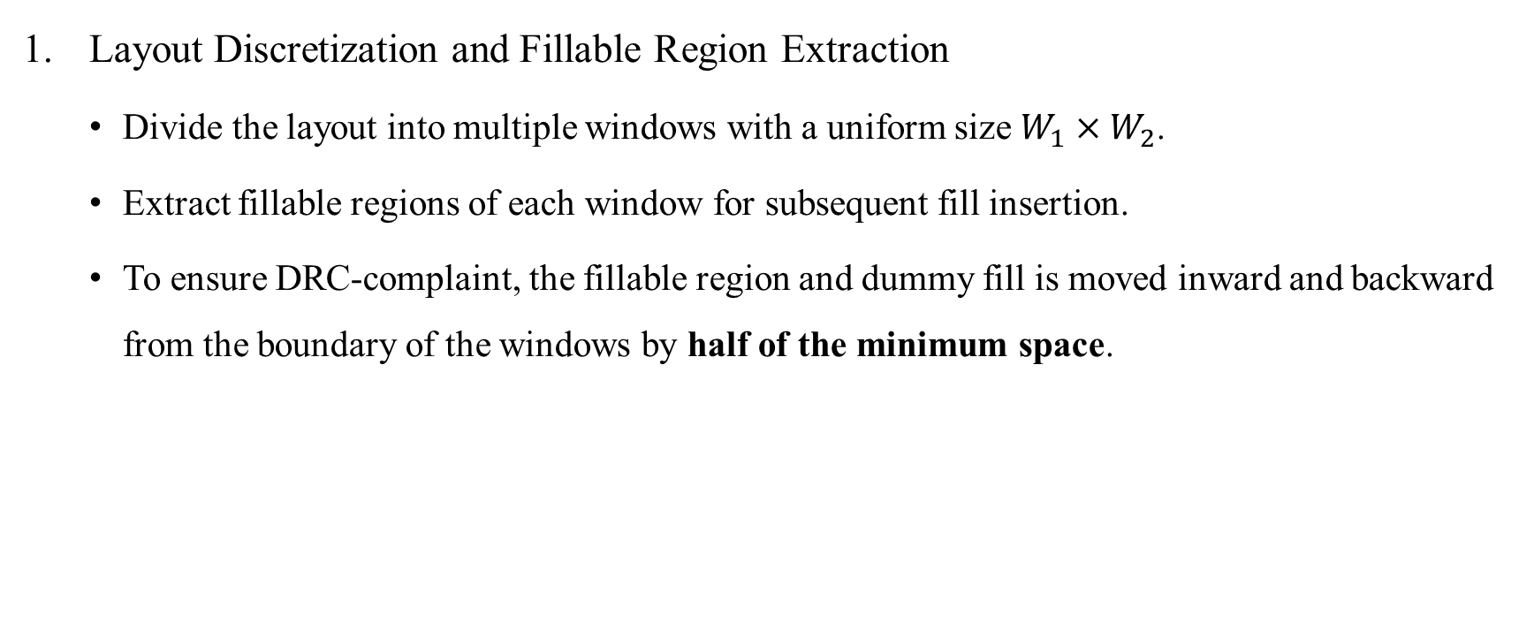
MOGA-CmpCNN Framework
Layout Discretization and Fillable Region Extraction
Divide the layout into multiple windows with a uniform size $W_{1}×W_{2}$.
Extract fillable regions of each window for subsequent fill insertion.
To ensure DRC-complaint, the fillable region and dummy fill is moved inward and backward from the boundary of the windows by half of the minimum space.
Notes:
* 這樣就有符合minimum spacing的要求了

Slide 8
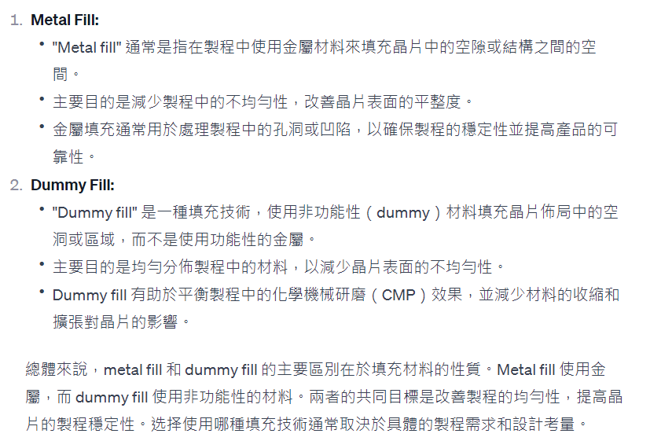

Slide 9
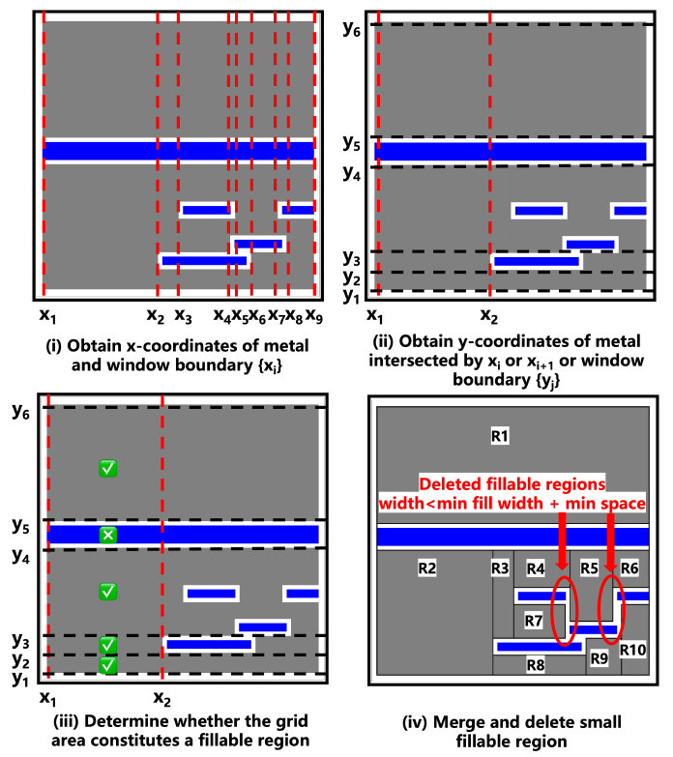
Notes:
找出所有metal跟windows的boundary {xi}
依序(x1,x2), (x2,x3)…
找出與這個邊界有交集的metal的y
決定他是不是fillable region (應該就是沒有metal)
若fillable region的寬度小於min_fill_width + min_space的話，就把她刪除
若寬度相同，可以合併

Slide 10
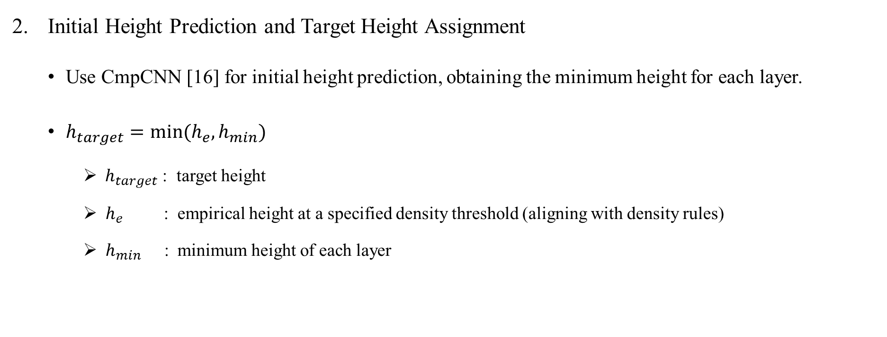
MOGA-CmpCNN Framework
Initial Height Prediction and Target Height Assignment
Use CmpCNN [16] for initial height prediction, obtaining the minimum height for each layer.
$h_{target}=min⁡(h_{e}, h_{min})$
$h_{target}$ : target height
$h_{e}$ : empirical height at a specified density threshold (aligning with density rules)
$h_{min}$ : minimum height of each layer
Notes:
* 這樣就有符合minimum spacing的要求了

Slide 11
MOGA-CmpCNN Framework
MOGA-CmpCNN Fill Insertion
Notes:
* 這樣就有符合minimum spacing的要求了

Slide 12
Thank you for listening!

